Slide 1



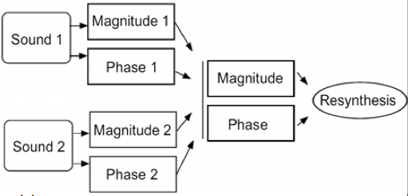
Mutation
DFT bins have magnitude and phase
Suppose we have DFTs of two signals
Combine magnitudes and phases in interesting combinations
Sometimes known as cross-synthesis or morphing
For example, magnitude from one, phase from other

Slide 2
Mutation
Example operations on magnitude only
Multiplication: r = r1 * r2
Multiplication in linear terms = addition in dB scale
Similar to spectral AND operation, keeping zones where energy is located in both signals
For fixed r2 (and zero phase z2), equivalent to FIR filtering
Addition: r = r1 + r2
Similar to spectral OR operation
Not simple mixing: only operating on magnitudes, not phases
Masking: r = (r2 > threshold ? r1 : 0)
Keep magnitude of one sound only if the other is above a threshold
(A ? B : C) syntax means “if A, then B, otherwise C”

Slide 3
Mutation
Phase is critical to time-frequency representations
Explains how signals evolve from frame to frame
Has an important influence on output quality
Example operations on phase of two inputs
Keep phase of only one sound, change magnitude
Phase is a strong cue for pitch of sound (why?)
Result: pitch influenced by the phase you keep
Add phases
Strong alteration: phase moves at double speed on average
Or double the reconstruction hop size: n2 = 2 * n1
Arbitrary combination or variation on phases

Slide 4
Denoising
Removal of unwanted low level sounds not intended to be in signal
Reduce unwanted low level sound on musical recording usually 'hiss' or 'hums'
Remove artefacts produced by nonlinear operations
Minimize unwanted low level (generally high) frequencies
Noise from any number of sources
usually appears as high frequency 'hiss', or low level 'hum'
Goals
achieve clean crisp signal by reducing overall noise
Don’t disrupt wanted signal
Denoising performed using analysis and synthesis
extract magnitude and phase information
Phase unchanged
Low magnitudes attenuated

Slide 5


Denoising
Two basic nonlinear algorithms:
and
x is input signal, c is noise reduction coefficient
Another example implementation:
Similar to applying noise gate
However, operates on each frequency component
Only magnitude modified; phase remains as it was
function ft = denoise(f,r,coef)
if abs(f) >= 0.001
ft = f.*(r./(r+coef));
else
ft = f.*(r./(r+sqrt(coef)));
end

Slide 6
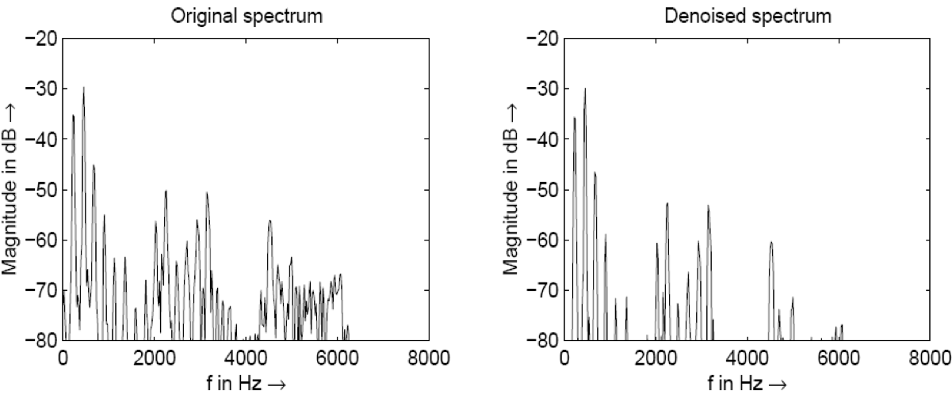
Denoising
Example spectra for windowed FFT of flute sound
Left: input signal
Right: output according to with c = 0.01

Slide 7
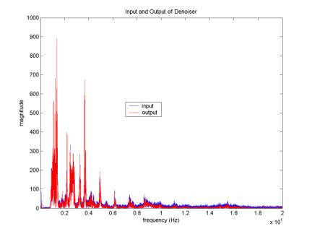

Denoising example
Denoising reduces amplitudes of each bin
Need to boost overall signal level to maintain loudness
Similar to dynamic range compressor
In this example, gain of 4.75 to restore level

Slide 8
Denoising variations
Analyse noise content first
Apply different nonlinear function to each bin
For example, reducing ventilation noise in a room
Time-varying noise estimation
Estimate noise threshold as function of spectrum
Often involves LPC or cepstral techniques
Use noise estimation to decrease pumping effects
Denoising is nonlinear and can produce artefacts
Small grains (spurious components) that jump out
Noise can also be a useful component of a sound

